Slide 1
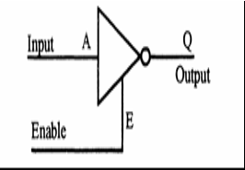
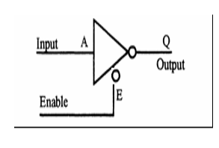
Tri-State Devices
Interfacing Device necessary to interconnect the components of bus-oriented system.
Devices essential for proper functioning of bus-oriented system.
have 3 states : logic 1, logic 0, and high impedance.
Trademark of National Semiconductor.
It is a useful device that allows us to control when current passes through the device, and when it doesn't.
Third line is called Enable is activated, tri-state device function same as ordinary logic device.

Slide 2
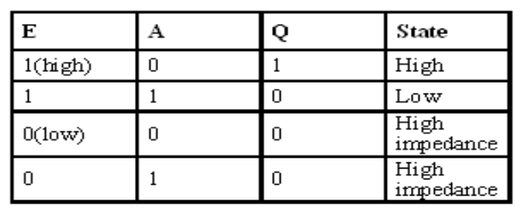
Tri-State Devices
When enable E is high the gate is enabled and the output Q can be 1 or 0 (if A is 0, Q is 1, otherwise Q is 0). However, when E is low the gate is disabled and the output Q enters into a high impedance state.

Slide 3
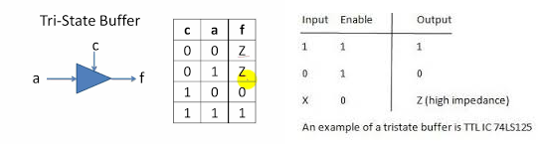

Slide 4
Instruction size
An instruction is assembled in the memory of a microcomputer system in binary form. The size of an instruction signifies how much memory space is required to load an instruction in the memory. 8085 instructions are of following sizes:
One-byte Instructions
e.g. MOV, ADD, ANA, SUB, ORA etc.
Two-byte instructions
e.g. MVI, ADI, ANI, ORI, XRI etc.
Three-byte instructions
e.g. LXI, LDA, STA, LHLD, SHLD etc.

Slide 5
Addressing Modes
8085 instructions can be classified in following addressing modes
Register Addressing mode
Instructions which have their operands in registers only e.g. MOV, ADD, SUB, ANA, ORA, XRA etc.
Immediate Addressing mode
Instructions in which operand immediately follows the op-code e.g. MVI, LXI, ADI, SUI, ANI, ORI etc.
Direct Addressing mode
Instructions have their operands in memory and the 16-bit memory address is specified in the instruction e.g. LDA, STA, LHLD, SHLD etc.

Slide 6
Addressing Modes Contd..
Register Indirect Addressing mode
Instructions have their operand in memory and the 16-bit memory address is specified in a register pair e.g. LDAX, STAX, PUSH, POP etc.
Implicit Addressing mode
These instruction have their operand implied in the op-code itself e.g. CMA, CMC, STC etc.

Slide 7
Instruction Set of 8085
An instruction is a binary pattern designed inside a microprocessor to perform a specific function.
The entire group of instructions that a microprocessor supports is called Instruction Set.
8085 has 246 instructions.
Each instruction is represented by an 8-bit binary value.
These 8-bits of binary value is called Op-Code or Instruction Byte.

Slide 8
Classification of Instruction Set
Data Transfer Instruction
Arithmetic Instructions
Logical Instructions
Branching Instructions
Control Instructions

Slide 9
1.Data Transfer Instructions
These instructions move data between registers, or between memory and registers.
These instructions copy data from source to destination(without changing the original data).

Slide 10
MOV-Copy from source to destination
Opcode | Operand
MOV | Rd, Rs M, Rs Rd, M
This instruction copies the contents of the source register into the destination register. (contents of the source register are not altered)
If one of the operands is a memory location, its location is specified by the contents of the HL registers.
Example: MOV B, C or MOV B, M

Slide 11
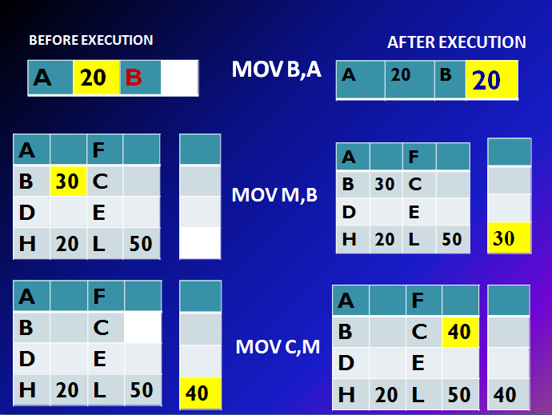

Slide 12
MVI-Move immediate 8-bit
Opcode | Operand
MVI | Rd, Data M, Data
The 8-bit data is stored in the destination register or memory.
If the operand is a memory location, its location is specified by the contents of the H-L registers.
Example: MVI B, 60H or MVI M, 40H

Slide 13
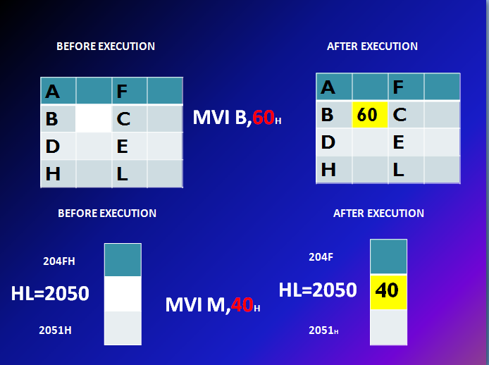

Slide 14
LDA-Load accumulator
Opcode | Operand
LDA | 16-bit address
The contents of a memory location, specified by a 16-bit address in the operand, are copied to the accumulator.
The contents of the source are not altered.
Example: LDA 2000H

Slide 15
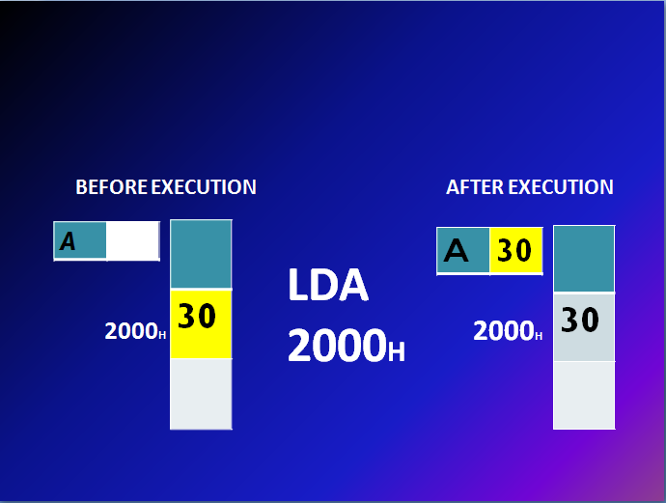

Slide 16
LDAX-Load accumulator indirect
Opcode | Operand
LDAX | B/D Register Pair
The contents of the designated register pair point to a memory location.
This instruction copies the contents of that memory location into the accumulator.
The contents of either the register pair or the memory location are not altered.
Example: LDAX D

Slide 17
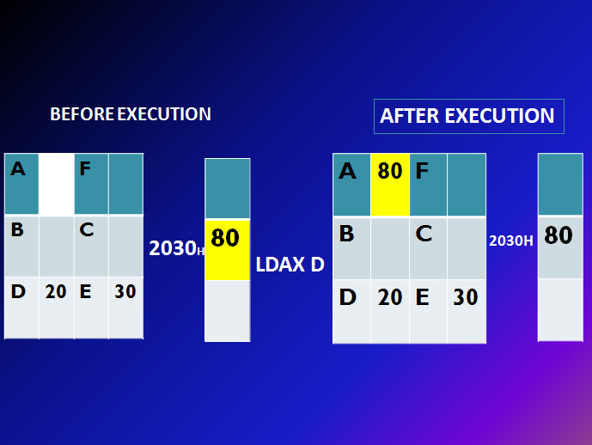

Slide 18
LXI-Load register pair immediate
Opcode | Operand
LXI | Reg. pair, 16-bit data
This instruction loads 16-bit data in the register pair.
Example: LXI H, 2030 H

Slide 19
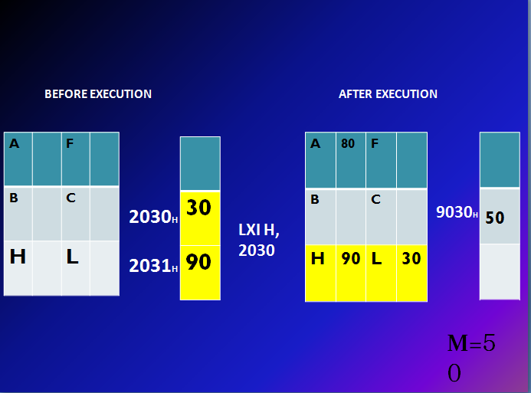

Slide 20
LHLD-Load H and L registers direct
Opcode | Operand
LHLD | 16-bit address
This instruction copies the contents of memory location pointed out by 16-bit address into register L.
It copies the contents of next memory location into register H.
Example: LHLD 2030 H

Slide 21


Slide 22
STA-Store accumulator direct
Opcode | Operand
STA | 16-bit address
The contents of accumulator are copied into the memory location specified by the operand.
Example: STA 2000H

Slide 23
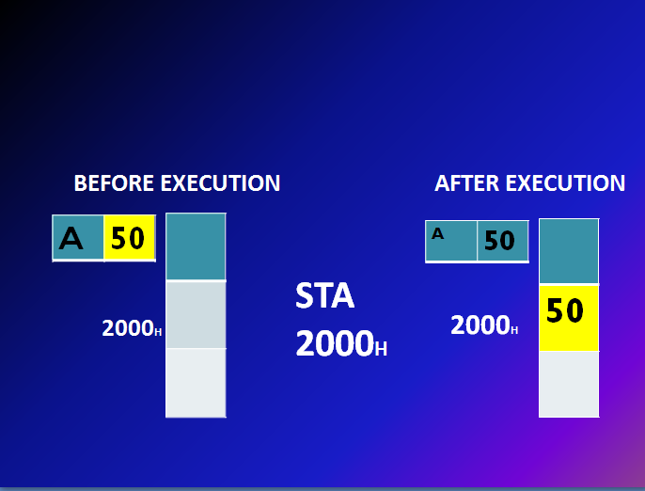

Slide 24
STAX-Store accumulator indirect
Opcode | Operand
STAX | Reg. pair
The contents of accumulator are copied into the memory location specified by the contents of the register pair.
Example: STAX B

Slide 25
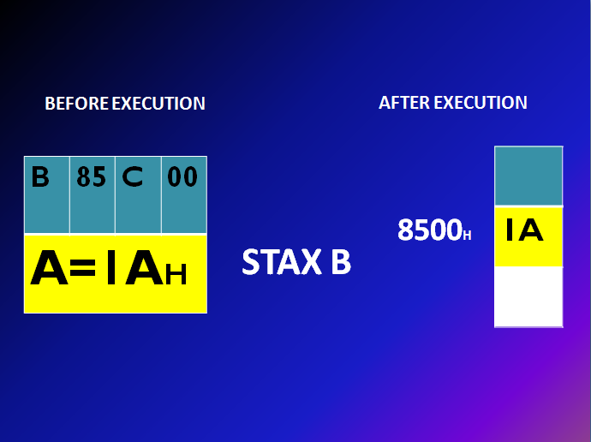

Slide 26
SHLD-Store H and L registers direct
Opcode | Operand
SHLD | 16-bit address
The contents of register L are stored into memory location specified by the 16-bit address.
The contents of register H are stored into the next memory location.
Example: SHLD 2550H

Slide 27
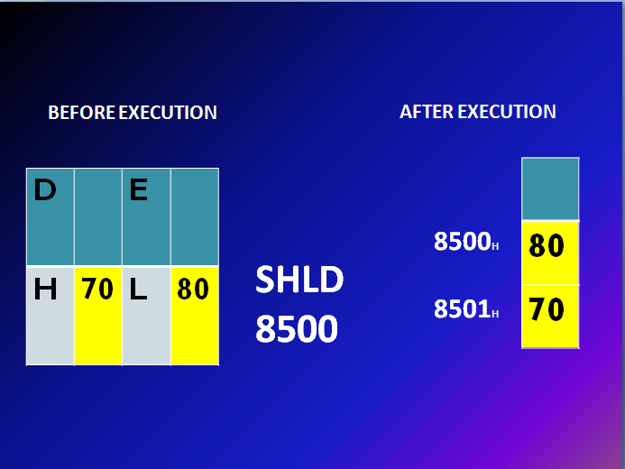

Slide 28
XCHG-Exchange H and L with D and E
Opcode | Operand
XCHG | None
The contents of register H are exchanged with the contents of register D.
The contents of register L are exchanged with the contents of register E.
Example: XCHG

Slide 29
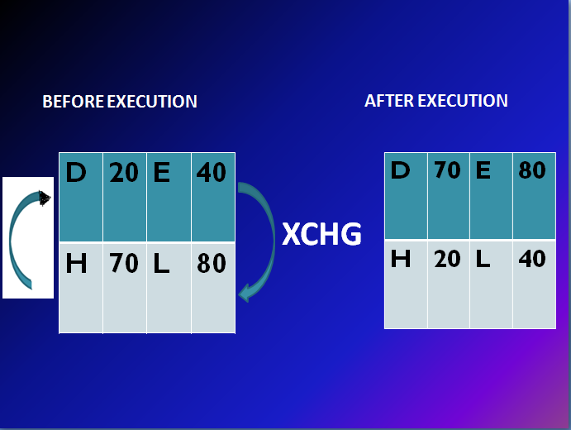

Slide 30
SPHL-Copy H and L registers to the stack pointer
Opcode | Operand
SPHL | None
This instruction loads the contents of H-L pair into SP.
Example: SPHL

Slide 31
BEFORE EXECUTION
SP
H | 25 | L | 00
SPHL
AFTER EXECUTION
SP | 2500
H | 25 | L | 00

Slide 32
XTHL-Exchange H and L with top of stack
Opcode | Operand
XTHL | None
The contents of L register are exchanged with the location pointed out by the contents of the SP.
The contents of H register are exchanged with the next location (SP + 1).
Example: XTHL

Slide 33
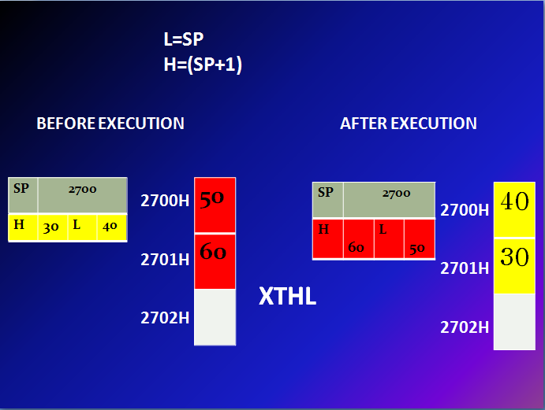

Slide 34
Opcode | Operand | Description
PCHL | None | Load program counter with H-L contents
The contents of registers H and L are copied into the program counter (PC).
The contents of H are placed as the high-order byte and the contents of L as the low-order byte.
Example: PCHL

Slide 35
PUSH-Push register pair onto stack
Opcode | Operand
PUSH | Reg. pair
The contents of register pair are copied onto stack.
SP is decremented and the contents of high-order registers (B, D, H, A) are copied into stack.
SP is again decremented and the contents of low-order registers (C, E, L, Flags) are copied into stack.
Example: PUSH B

Slide 36
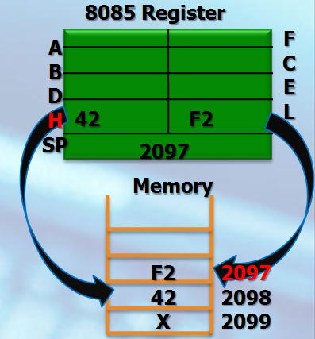
PUSH H

Slide 37
POP- Pop stack to register pair
Opcode | Operand
POP | Reg. pair
The contents of top of stack are copied into register pair.
The contents of location pointed out by SP are copied to the low-order register (C, E, L, Flags).
SP is incremented and the contents of location are copied to the high-order register (B, D, H, A).
Example: POP H

Slide 38
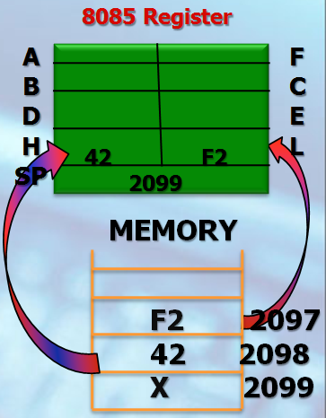
POP H

Slide 39
IN- Copy data to accumulator from a port with 8-bit address
Opcode | Operand
IN | 8-bit port address
The contents of I/O port are copied into accumulator.
Example: IN 8C H

Slide 40
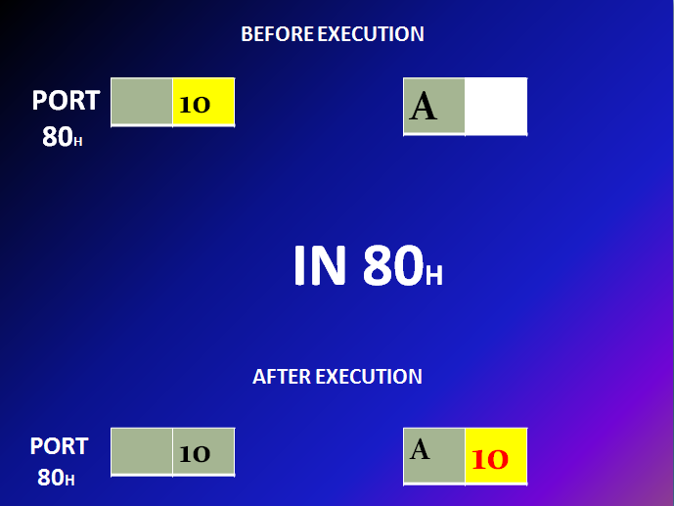

Slide 41
OUT- Copy data from accumulator to a port with 8-bit address
Opcode | Operand
OUT | 8-bit port address
The contents of accumulator are copied into the I/O port.
Example: OUT 78H

Slide 42
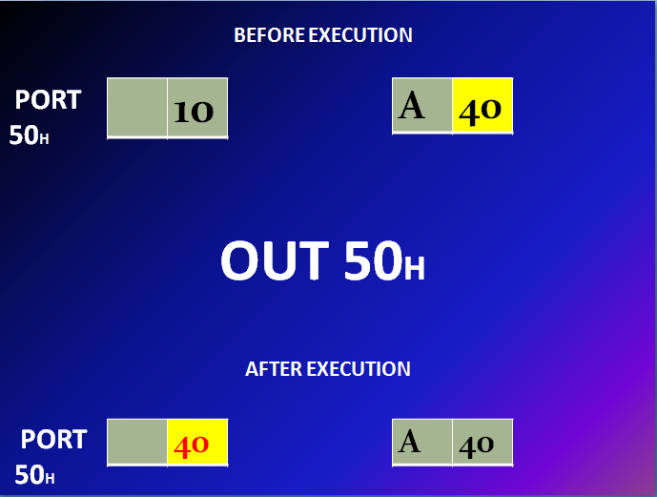

Slide 43
2.Arithmetic Instructions
These instructions perform the operations like:
Addition
Subtract
Increment
Decrement

Slide 44
Addition
Any 8-bit number, or the contents of register, or the contents of memory location can be added to the contents of accumulator.
The result (sum) is stored in the accumulator.
No two other 8-bit registers can be added directly.
Example: The contents of register B cannot be added directly to the contents of register C.

Slide 45
ADD
Opcode | Operand | Description
ADD | R M | Add register or memory to accumulator
The contents of register or memory are added to the contents of accumulator.
The result is stored in accumulator.
If the operand is memory location, its address is specified by H-L pair.
Example: ADD B or ADD M

Slide 46
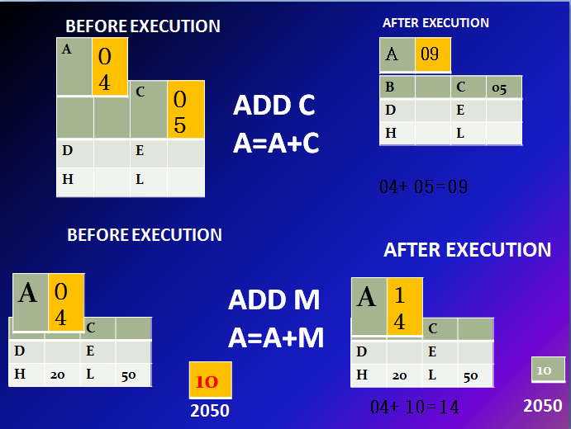

Slide 47
ADC
Opcode | Operand | Description
ADC | R M | Add register or memory to accumulator with carry
The contents of register or memory and Carry Flag (CY) are added to the contents of accumulator.
The result is stored in accumulator.
If the operand is memory location, its address is specified by H-L pair.
All flags are modified to reflect the result of the addition.
Example: ADC B or ADC M

Slide 48
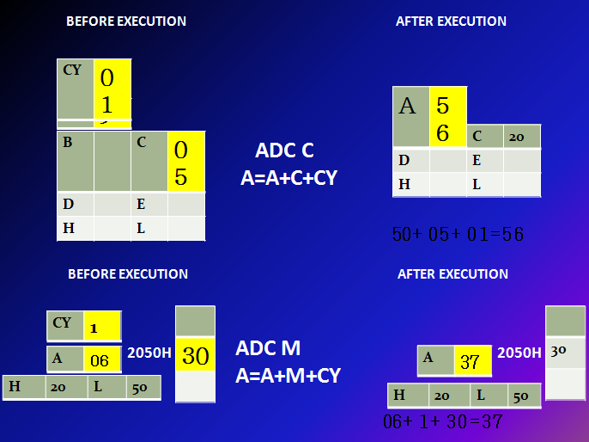

Slide 49
ADI
Opcode | Operand | Description
ADI | 8-bit data | Add immediate to accumulator
The 8-bit data is added to the contents of accumulator.
The result is stored in accumulator.
All flags are modified to reflect the result of the addition.
Example: ADI 45 H

Slide 50
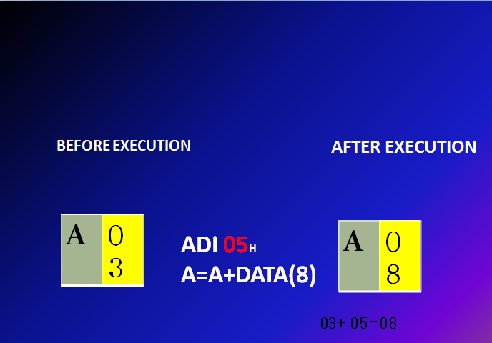

Slide 51
ACI
Opcode | Operand | Description
ACI | 8-bit data | Add immediate to accumulator with carry
The 8-bit data and the Carry Flag (CY) are added to the contents of accumulator.
The result is stored in accumulator.
All flags are modified to reflect the result of the addition.
Example: ACI 45 H

Slide 52
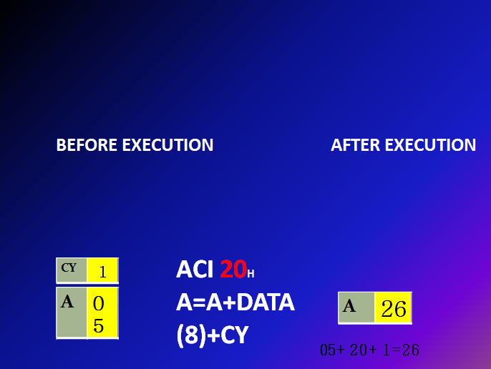

Slide 53
DAD
Opcode | Operand | Description
DAD | Reg. pair | Add register pair to H-L pair
The 16-bit contents of the register pair are added to the contents of H-L pair.
The result is stored in H-L pair.
If the result is larger than 16 bits, then CY is set.
No other flags are changed.
Example: DAD B or DAD D

Slide 54
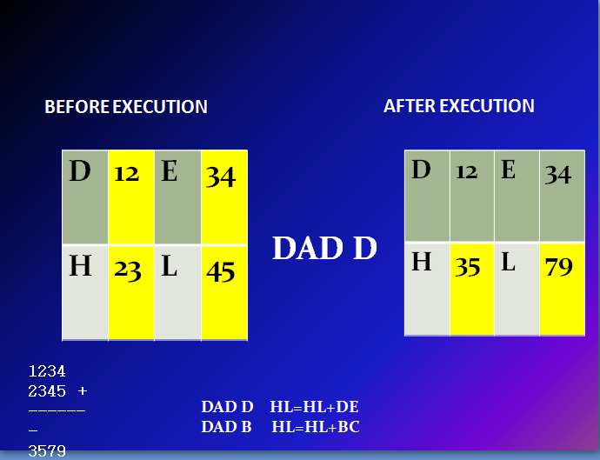

Slide 55
Subtraction
Any 8-bit number, or the contents of register, or the contents of memory location can be subtracted from the contents of accumulator.
The result is stored in the accumulator.
Subtraction is performed in 2’s complement form.
If the result is negative, it is stored in 2’s complement form.
No two other 8-bit registers can be subtracted directly.

Slide 56
SUB
Opcode | Operand | Description
SUB | R M | Subtract register or memory from accumulator
The contents of the register or memory location are subtracted from the contents of the accumulator.
The result is stored in accumulator.
If the operand is memory location, its address is specified by H-L pair.
All flags are modified to reflect the result of subtraction.
Example: SUB B or SUB M

Slide 57
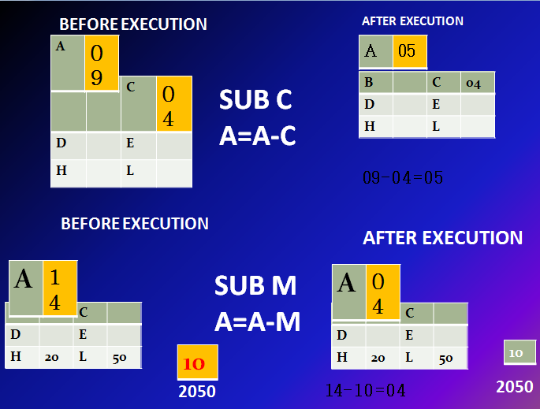

Slide 58
SBB
Opcode | Operand | Description
SBB | R M | Subtract register or memory from accumulator with borrow
The contents of the register or memory location and Borrow Flag (i.e. CY) are subtracted from the contents of the accumulator.
The result is stored in accumulator.
If the operand is memory location, its address is specified by H-L pair.
All flags are modified to reflect the result of subtraction.
Example: SBB B or SBB M

Slide 59
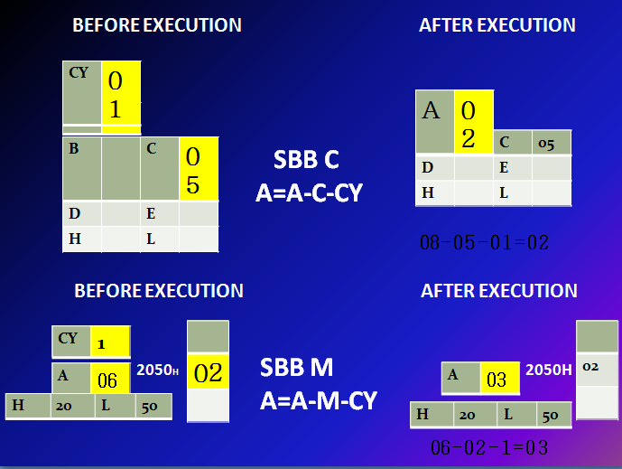

Slide 60
SUI
Opcode | Operand | Description
SUI | 8-bit data | Subtract immediate from accumulator
The 8-bit data is subtracted from the contents of the accumulator.
The result is stored in accumulator.
All flags are modified to reflect the result of subtraction.
Example: SUI 05H

Slide 61
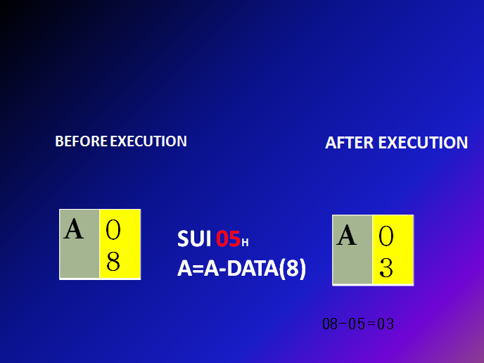

Slide 62
SBI
Opcode | Operand | Description
SBI | 8-bit data | Subtract immediate from accumulator with borrow
The 8-bit data and the Borrow Flag (i.e. CY) is subtracted from the contents of the accumulator.
The result is stored in accumulator.
All flags are modified to reflect the result of subtraction.
Example: SBI 45 H

Slide 63
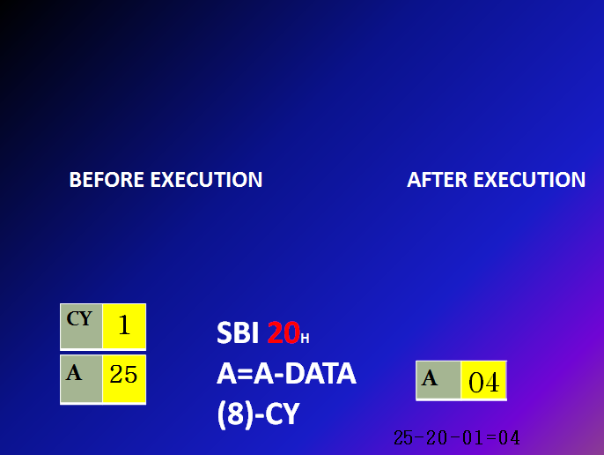

Slide 64
Increment / Decrement
The 8-bit contents of a register or a memory location can be incremented or decremented by 1.
The 16-bit contents of a register pair can be incremented or decremented by 1.
Increment or decrement can be performed on any register or a memory location.

Slide 65
INR
Opcode | Operand | Description
INR | R M | Increment register or memory by 1
The contents of register or memory location are incremented by 1.
The result is stored in the same place.
If the operand is a memory location, its address is specified by the contents of H-L pair.
Example: INR B or INR M

Slide 66
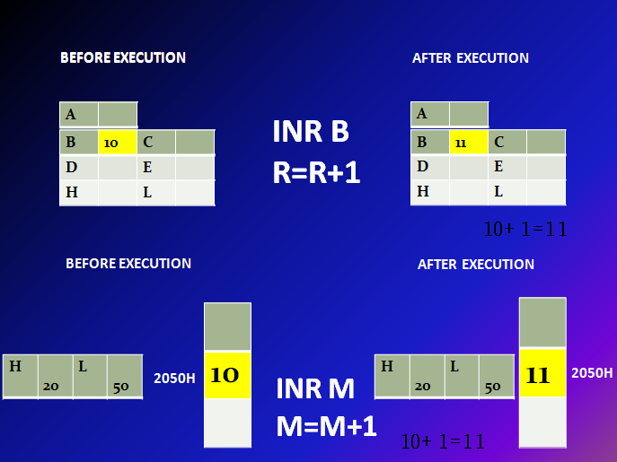

Slide 67
INX
Opcode | Operand | Description
INX | R | Increment register pair by 1
The contents of register pair are incremented by 1.
The result is stored in the same place.
Example: INX H or INX B or INX D

Slide 68
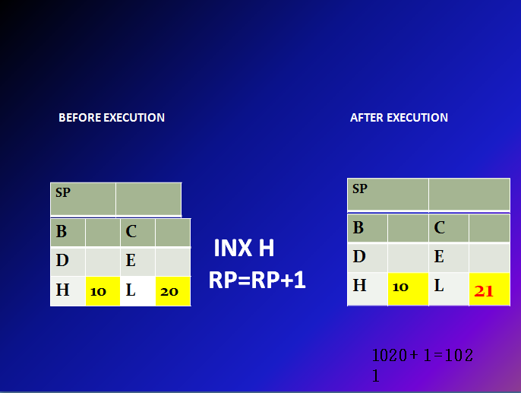

Slide 69
DCR
Opcode | Operand | Description
DCR | R M | Decrement register or memory by 1
The contents of register or memory location are decremented by 1.
The result is stored in the same place.
If the operand is a memory location, its address is specified by the contents of H-L pair.
Example: DCR B or DCR M

Slide 70
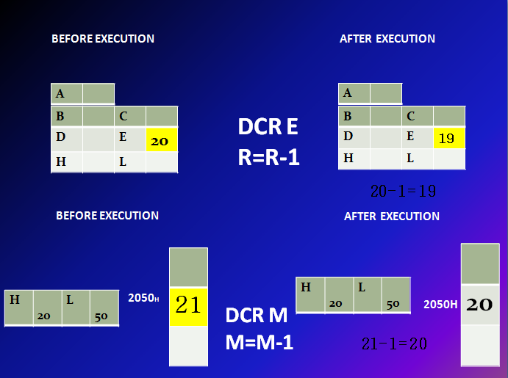

Slide 71
DCX
Opcode | Operand | Description
DCX | R | Decrement register pair by 1
The contents of register pair are decremented by 1.
The result is stored in the same place.
Example: DCX H or DCX B or DCX D

Slide 72
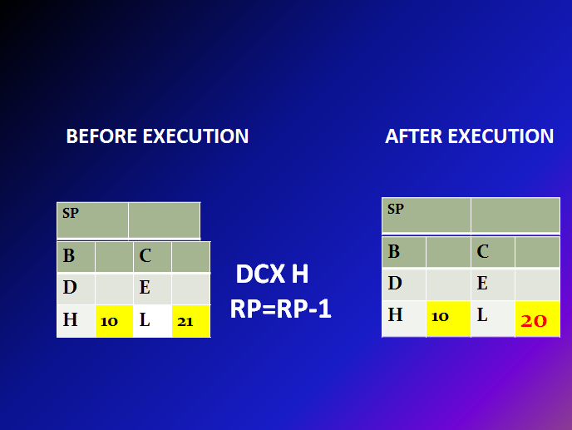

Slide 73
3.Logical Instructions
These instructions perform logical operations on data stored in registers, memory and status flags.
The logical operations are:
AND
OR
XOR
Rotate
Compare
Complement

Slide 74
AND, OR, XOR
Any 8-bit data, or the contents of register, or memory location can logically have
AND operation
OR operation
XOR operation
with the contents of accumulator.
The result is stored in accumulator.

Slide 75
Opcode | Operand | Description
ANA | R M | Logical AND register or memory with accumulator
The contents of the accumulator are logically ANDed with the contents of register or memory.
The result is placed in the accumulator.
If the operand is a memory location, its address is specified by the contents of H-L pair.
S, Z, P are modified to reflect the result of the operation.
CY is reset and AC is set.
Example: ANA B or ANA M.

Slide 76
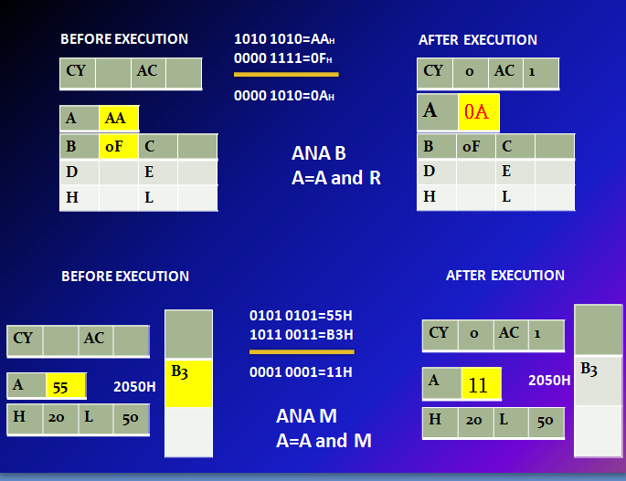

Slide 77
Opcode | Operand | Description
ANI | 8-bit data | Logical AND immediate with accumulator
The contents of the accumulator are logically ANDed with the 8-bit data.
The result is placed in the accumulator.
S, Z, P are modified to reflect the result.
CY is reset, AC is set.
Example: ANI 86H.

Slide 78
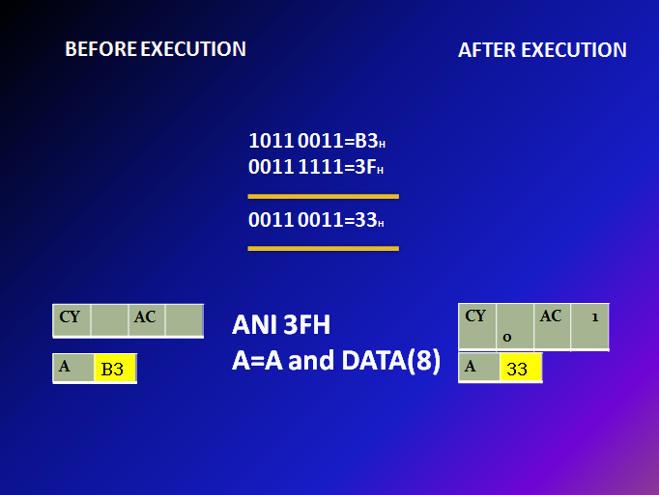

Slide 79
Opcode | Operand | Description
ORA | R M | Logical OR register or memory with accumulator
The contents of the accumulator are logically ORed with the contents of the register or memory.
The result is placed in the accumulator.
If the operand is a memory location, its address is specified by the contents of H-L pair.
S, Z, P are modified to reflect the result.
CY and AC are reset.
Example: ORA B or ORA M.

Slide 80
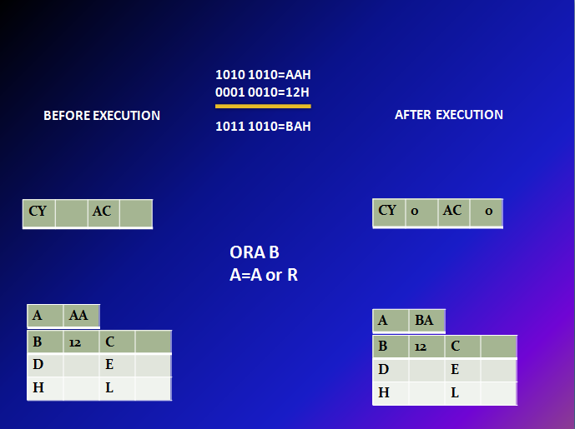

Slide 81
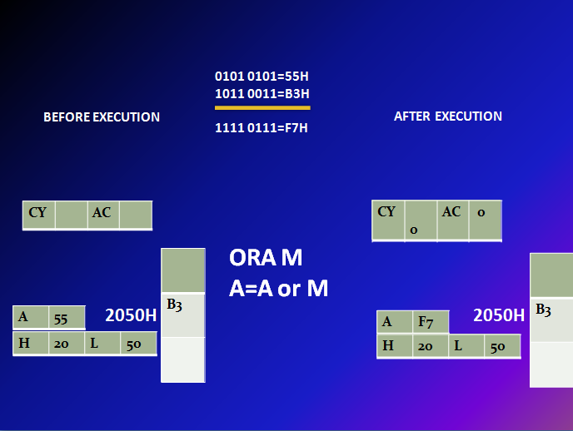

Slide 82
Opcode | Operand | Description
ORI | 8-bit data | Logical OR immediate with accumulator
The contents of the accumulator are logically ORed with the 8-bit data.
The result is placed in the accumulator.
S, Z, P are modified to reflect the result.
CY and AC are reset.
Example: ORI 86H.

Slide 83
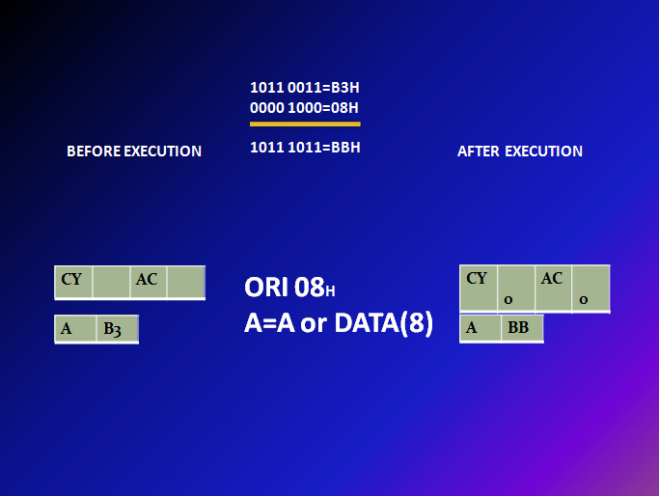

Slide 84
Opcode | Operand | Description
XRA | R M | Logical XOR register or memory with accumulator
The contents of the accumulator are XORed with the contents of the register or memory.
The result is placed in the accumulator.
If the operand is a memory location, its address is specified by the contents of H-L pair.
S, Z, P are modified to reflect the result of the operation.
CY and AC are reset.
Example: XRA B or XRA M.

Slide 85
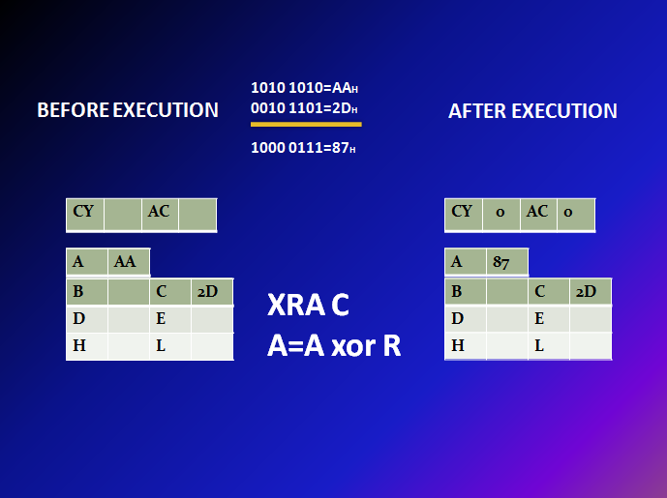

Slide 86
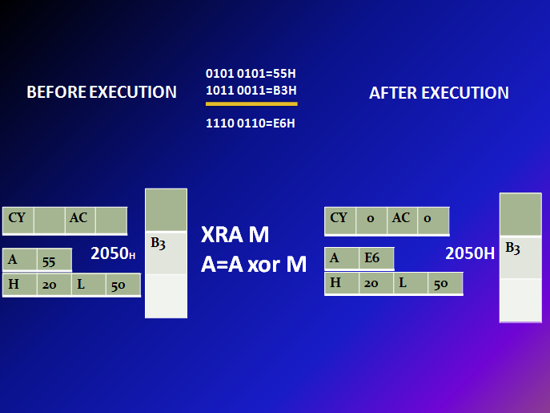

Slide 87
Opcode | Operand | Description
XRI | 8-bit data | XOR immediate with accumulator
The contents of the accumulator are XORed with the 8-bit data.
The result is placed in the accumulator.
S, Z, P are modified to reflect the result.
CY and AC are reset.
Example: XRI 86H.

Slide 88
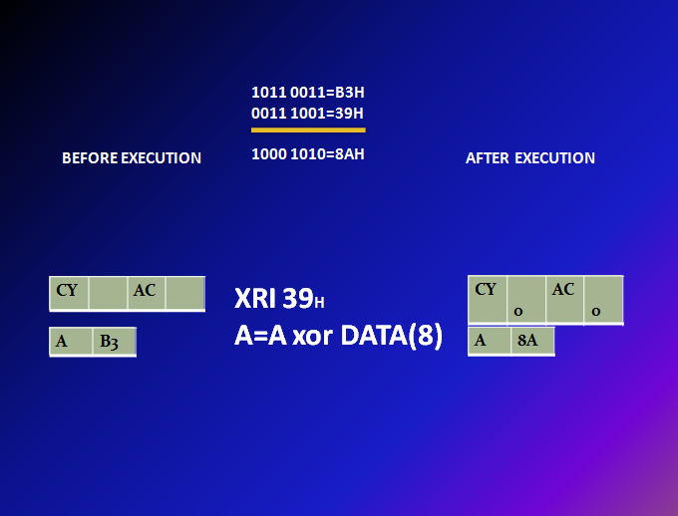

Slide 89
Compare
Any 8-bit data, or the contents of register, or memory location can be compares for:
Equality
Greater Than
Less Than
with the contents of accumulator.
The result is reflected in status flags.

Slide 90
Opcode | Operand | Description
CMP | R M | Compare register or memory with accumulator
The contents of the operand (register or memory) are compared with the contents of the accumulator.
Both contents are preserved .

Slide 91
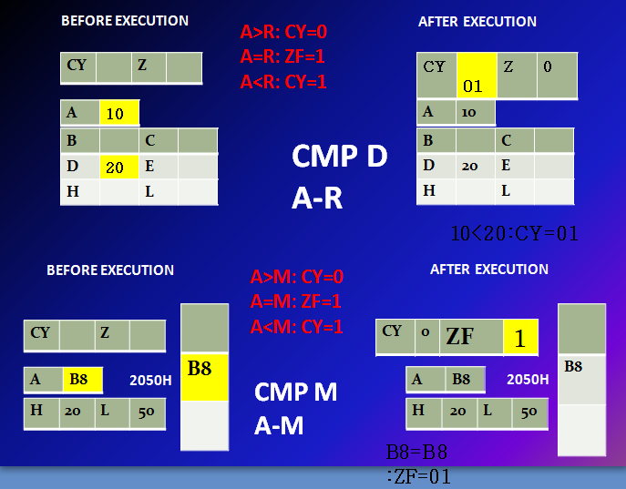

Slide 92
Opcode | Operand | Description
CPI | 8-bit data | Compare immediate with accumulator
The 8-bit data is compared with the contents of accumulator.
The values being compared remain unchanged.

Slide 93
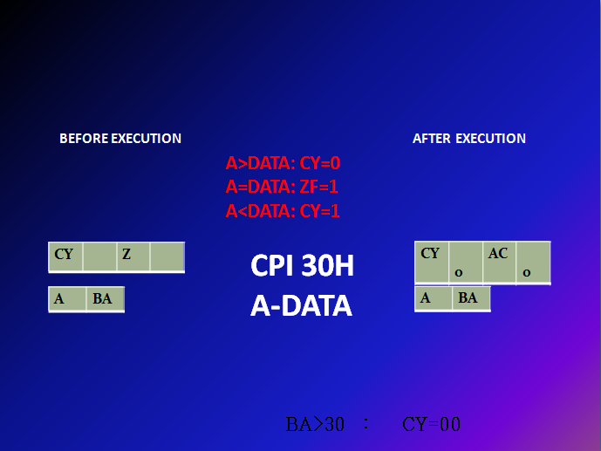

Slide 94
Rotate
Each bit in the accumulator can be shifted either left or right to the next position.

Slide 95
Opcode | Operand | Description
RLC | None | Rotate accumulator left
Each binary bit of the accumulator is rotated left by one position.
Bit D7 is placed in the position of D0 as well as in the Carry flag.
CY is modified according to bit D7.
S, Z, P, AC are not affected.
Example: RLC.

Slide 96
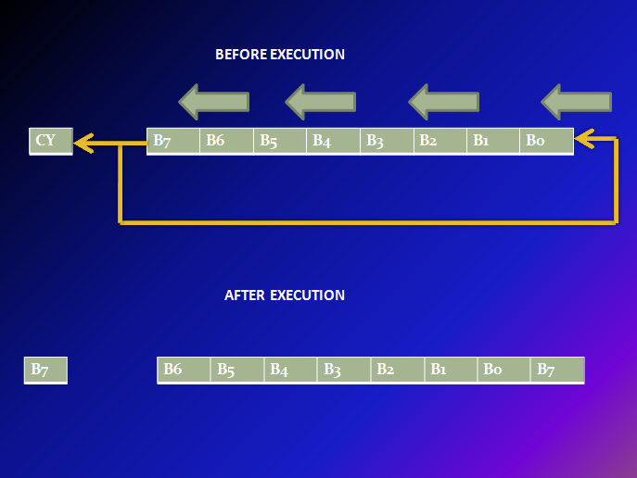

Slide 97
Opcode | Operand | Description
RRC | None | Rotate accumulator right
Each binary bit of the accumulator is rotated right by one position.
Bit D0 is placed in the position of D7 as well as in the Carry flag.
CY is modified according to bit D0.
S, Z, P, AC are not affected.
Example: RRC.

Slide 98
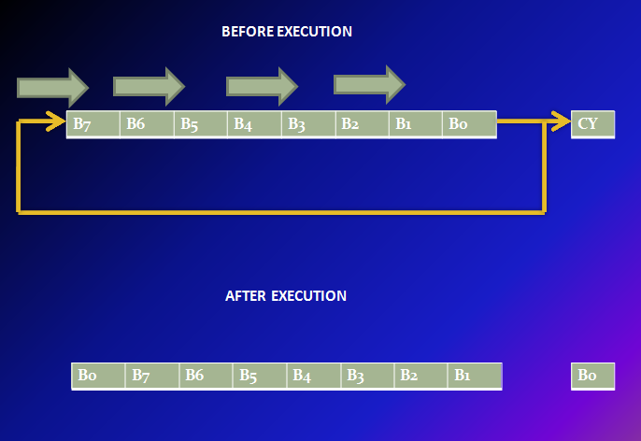

Slide 99
Opcode | Operand | Description
RAL | None | Rotate accumulator left through carry
Each binary bit of the accumulator is rotated left by one position through the Carry flag.
Bit D7 is placed in the Carry flag, and the Carry flag is placed in the least significant position D0.
CY is modified according to bit D7.
S, Z, P, AC are not affected.
Example: RAL.

Slide 100
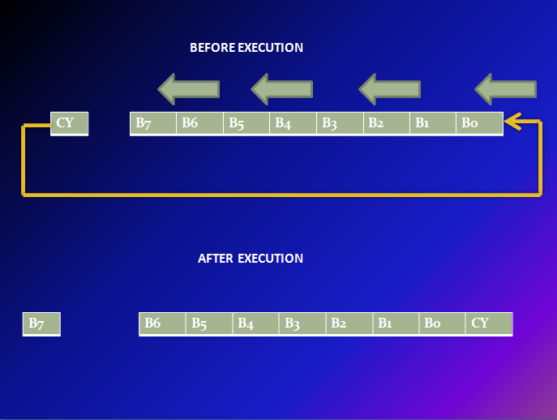

Slide 101
Opcode | Operand | Description
RAR | None | Rotate accumulator right through carry
Each binary bit of the accumulator is rotated right by one position through the Carry flag.
Bit D0 is placed in the Carry flag, and the Carry flag is placed in the most significant position D7.
CY is modified according to bit D0.
S, Z, P, AC are not affected.
Example: RAR.

Slide 102
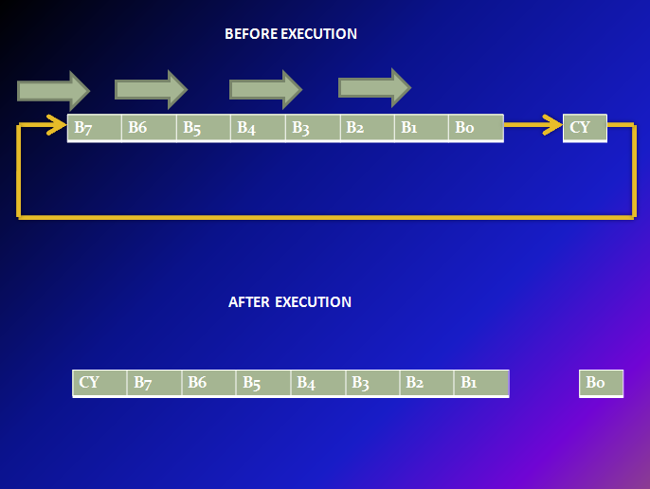

Slide 103
Complement
The contents of accumulator can be complemented.
Each 0 is replaced by 1 and each 1 is replaced by 0.

Slide 104
Opcode | Operand | Description
CMA | None | Complement accumulator
The contents of the accumulator are complemented.
No flags are affected.
Example: CMA. A=A’
BEFORE EXECUTION
AFTER EXECUTION
A | FF
A | 00

Slide 105
Opcode | Operand | Description
CMC | None | Complement carry
The Carry flag is complemented.
No other flags are affected.
Example: CMC => c=c’
BEFORE EXECUTION
AFTER EXECUTION
C | 00
C | FF

Slide 106
Opcode | Operand | Description
STC | None | Set carry
The Carry flag is set to 1.
No other flags are affected.
Example: STC CF=1
S-set (1) C-clear (0)

Slide 107
4.Branching Instructions
The branch group instructions allows the microprocessor to change the sequence of program either unconditionally or under certain test conditions. The group includes,
(1) Jump instructions,
(2) Call and Return instructions,
(3) Restart instructions,

Slide 108
Opcode | Operand | Description
JMP | 16-bit address | Jump unconditionally
The program sequence is transferred to the memory location specified by the 16-bit address given in the operand.
Example: JMP 2034 H.

Slide 109
Opcode | Operand | Description
Jx | 16-bit address | Jump conditionally
The program sequence is transferred to the memory location specified by the 16-bit address given in the operand based on the specified flag of the PSW.
Example: JZ 2034 H.

Slide 110
Jump Conditionally
Opcode | Description | Status Flags
JC | Jump if Carry | CY = 1
JNC | Jump if No Carry | CY = 0
JZ | Jump if Zero | Z = 1
JNZ | Jump if No Zero | Z = 0
JPE | Jump if Parity Even | P = 1
JPO | Jump if Parity Odd | P = 0
A-Above , B-Below , C-Carry , Z-Zero , P-Parity

Slide 111
Opcode | Operand | Description
CALL | 16-bit address | Call unconditionally
The program sequence is transferred to the memory location specified by the 16-bit address given in the operand.
Before the transfer, the address of the next instruction after CALL (the contents of the program counter) is pushed onto the stack.
Example: CALL 2034 H.

Slide 112
Call Conditionally
Opcode | Description | Status Flags
CC | Call if Carry | CY = 1
CNC | Call if No Carry | CY = 0
CP | Call if Positive | S = 0
CM | Call if Minus | S = 1
CZ | Call if Zero | Z = 1
CNZ | Call if No Zero | Z = 0
CPE | Call if Parity Even | P = 1
CPO | Call if Parity Odd | P = 0

Slide 113
Opcode | Operand | Description
RET | None | Return unconditionally
The program sequence is transferred from the subroutine to the calling program.
The two bytes from the top of the stack are copied into the program counter, and program execution begins at the new address.
Example: RET.

Slide 114
Return Conditionally
Opcode | Description | Status Flags
RC | Return if Carry | CY = 1
RNC | Return if No Carry | CY = 0
RP | Return if Positive | S = 0
RM | Return if Minus | S = 1
RZ | Return if Zero | Z = 1
RNZ | Return if No Zero | Z = 0
RPE | Return if Parity Even | P = 1
RPO | Return if Parity Odd | P = 0

Slide 115
Opcode | Operand | Description
RST | 0 – 7 | Restart (Software Interrupts)
The RST instruction jumps the control to one of eight memory locations depending upon the number.
These are used as software instructions in a program to transfer program execution to one of the eight locations.
Example: RST 1 or RST 2 ….

Slide 116
Instruction Code | Vector Address
RST 0 | 0*8=0000H
RST 1 | 1*8=0008H
RST 2 | 2*8=0010H
RST 3 | 3*8=0018H
RST 4 | 4*8=0020H
RST 5 | 5*8=0028H
RST 6 | 6*8=0030H
RST 7 | 7*8=0038H

Slide 117
5. Control Instructions
The control instructions control the operation of microprocessor.

Slide 118
Opcode | Operand | Description
NOP | None | No operation
No operation is performed.
The instruction is fetched and decoded but no operation is executed.
Example: NOP

Slide 119
Opcode | Operand | Description
HLT | None | Halt
The CPU finishes executing the current instruction and halts any further execution.
An interrupt or reset is necessary to exit from the halt state.
Example: HLT

Slide 120
Opcode | Operand | Description
DI | None | Disable interrupt
The interrupt enable flip-flop is reset and all the interrupts except the TRAP are disabled.
No flags are affected.
Example: DI

Slide 121
Opcode | Operand | Description
EI | None | Enable interrupt
The interrupt enable flip-flop is set and all interrupts are enabled.
No flags are affected.
This instruction is necessary to re-enable the interrupts (except TRAP).
Example: EI

Slide 122
Opcode | Operand | Description
RIM | None | Read Interrupt Mask
This is a multipurpose instruction used to read the status of interrupts 7.5, 6.5, 5.5 and read serial data input bit.
The instruction loads eight bits in the accumulator with the following interpretations.
Example: RIM

Slide 123
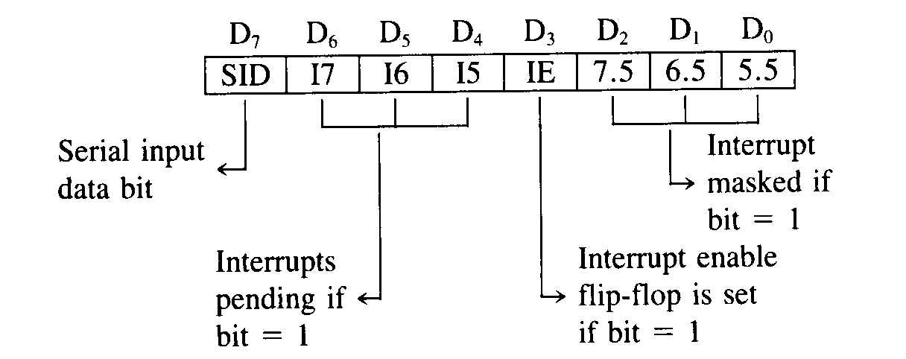
RIM Instruction

Slide 124
Opcode | Operand | Description
SIM | None | Set Interrupt Mask
This is a multipurpose instruction and used to implement the 8085 interrupts 7.5, 6.5, 5.5, and serial data output.
The instruction interprets the accumulator contents as follows.
Example: SIM

